Slide 1
Low Code Pipeline

Slide 2
Low Code Pipeline Goal
Enable user to create their own data pipelines without the use of code / SQL
According to company provided standards

Slide 3
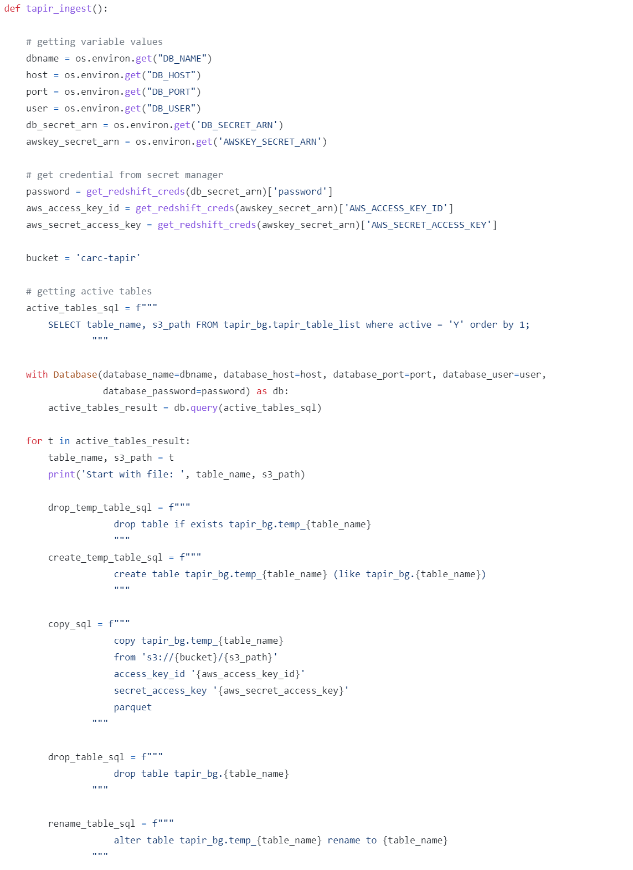
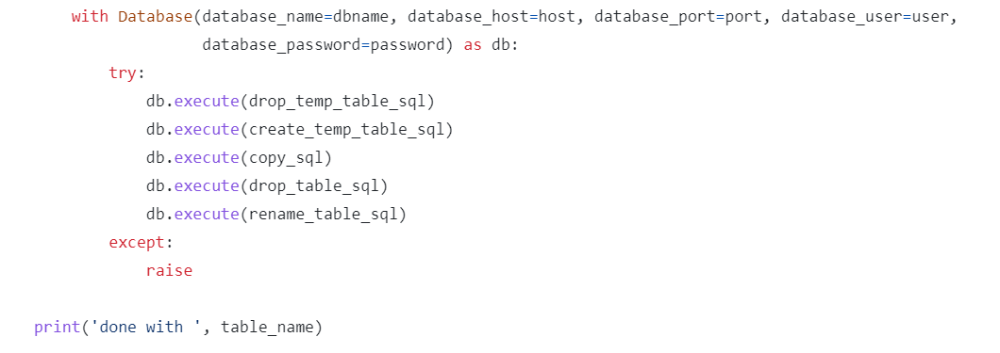
Ingest Tapir
Example code

Slide 4
Ingest Tapir
Get db name
Example code
194 words
Python Commands
SQL Commands
Yikes!
Get host
Get port
Get user
Execute drop
Get secret_arn
Execute create
Get password
Execute copy
Bucket location
Select Active tables
Get tables from database
Execute drop table
Execute rename table
Loop over active tables
With database
Drop tables in db SQL
Create temp tables in db SQL
except
Copy from s3 bucket to tapir_bg SQL
raise
Access key
Secret Access key
parquet
Rename table SQL
Drop table SQL
How could you ever do this in a “low code” manner??

Slide 5
Take a Step Back
language
Python
print(‘Hello World’)
One command
Does the computer understand this?

Slide 6
Take a Step Back
language
Python
print(‘Hello World’)
One command
Python Interpreter
language
Byte Code
Three commands
Does the computer understand this?

Slide 7
Take a Step Back
language
Python
print(‘Hello World’)
One command
Python Interpreter
language
Byte Code
Three commands
Virtual Machine (interpreter)
-written in c-
language
language
Assembly Code
language
Machine Code
010010101010010 010010100110100 010101100111010 010101010101011 010101010100101 010101010010111
~10,000 commands
The computer finally understands

Slide 8
Take a Step Back
Simpler
More concrete
More restricted
Slower
language
Python
print(‘Hello World’)
One command
Python Interpreter
language
Byte Code
Three commands
Virtual Machine (interpreter)
-written in c-
language
language
Assembly Code
language
Machine Code
010010101010010 010010100110100 010101100111010 010101010101011 010101010100101 010101010010111
~10,000 commands
More complicated
More abstract
Less restricted
Faster
Different languages proved layers of abstraction over the computer hardware

Slide 9
Ingest Tapir
Example code
194 words
Abstracted down
5 steps
Source Credentials
Destination Credentials
Connect to data source
Get tables
Copy tables to destination
You can summarize the complex code with 5 steps

Slide 10
Mapping out the low code pipeline
Source Credentials
Destination Credentials
Connect to data source
Get tables
Copy tables to destination
Start with the 5 steps and start to build the pipleline

Slide 11
Mapping out the low code pipeline
Source Credentials
Destination Credentials
S3 Bucket
Connect to data source
Get tables
Copy tables to destination
The user would drag a shape on to the screen. Shape corresponds to action: connect to data source

Slide 12
Mapping out the low code pipeline+
Note We could potentially have pre-populated credential boxes
Note that we are doing things out of the order of the code.
The low code pipeline user will think about things differently than a database analyst
User
Password
location
Source Credentials
Destination Credentials
S3 Bucket
Connect to data source
Get tables
Copy tables to destination
User clicks on the data source shape and enters credentials

Slide 13
Mapping out the low code pipeline
User
Password
location
Source Credentials
Destination Credentials
S3 Bucket
Get Tables
Connect to data source
Get tables
Copy tables to destination
User drags on a shape for get tables and connects the two shapes with an arrow connector

Slide 14
Mapping out the low code pipeline
User
Password
location
Source Credentials
Destination Credentials
S3 Bucket
Get Tables
Copy Tables
Connect to data source
Get tables
Copy tables to destination
The user select a shape for copy tables and connects to get tables

Slide 15
Mapping out the low code pipeline
Note We could potentially have pre-populated credential boxes
Database name
Host
Port
User
password
User
Password
location
Source Credentials
Destination Credentials
S3 Bucket
Get Tables
Copy Tables
Connect to data source
Get tables
Copy tables to destination
The user enters credentials for destination database

Slide 16
Mapping out the low code pipeline
variables
variables
Database name
Host
Port
User
password
User
Password
location
Source Credentials
Destination Credentials
S3 Bucket
Get Tables
Copy Tables
Connect to data source
Get tables
SQL
SQL + Python
Copy tables to destination
SQL + Python
Each shape will have corresponding SQL + Python code associated with it. In later versions this code could be customizable

Slide 17
Mapping out the low code pipeline
Source Credentials
Destination Credentials
S3 Bucket
Get Tables
Copy Tables
Connect to data source
Get tables
Copy tables to destination
The user has a nice clean low code pipeline to move tables from an S3 bucket to a database

Slide 18
Possible Future version
Group by
database
Get Tables
Join
S3 Bucket
Get Tables
Copy Tables
Future versions could involve data transformations such as joining tables or grouping by columns

